Slide 1


IT&CSA

Slide 2
Git and Source Control
Steven Palica
2022-07-21

Slide 3
Terms
Repository or Repo – A collection of files that are all tracked together
Commit – A snapshot of the state of a repository
GitHub – A commonly used service used to host repositories online
Branch – a separate copy of the repository
Merge – combining two branches together into one branch

Slide 4
Git

Slide 5
What is a commit?
A commit is
To add a file to a repository
A copy of each file
A snapshot of a repository
Made using the `git commit` command
git add <filename>
starts tracking the file as part of the repository
git commit –am "<commit message>"
the –a commits all changes to tracked files
The –m flag allows you to add the commit message (required) in the terminal (it opens a text editor otherwise)

Slide 6
Is Git useful if you are working alone?
Yes. Here are some things you can still do if you are working by yourself:
1. Make commits of working versions of documents that you can roll back to easily
2. Make branches for things that might break your code, then merge them back in
3. Keep a backup of code on a remote server
4. Code on multiple different computers without having to carry a thumb drive around
5. Use a CI/CD pipeline to test and/or deploy changes

Slide 7
What is a branch?
A branch is
A separate set of commits for the same repository
A way of working on separate features at the same time
A way of working on risky features without impacting the codebase

Slide 8
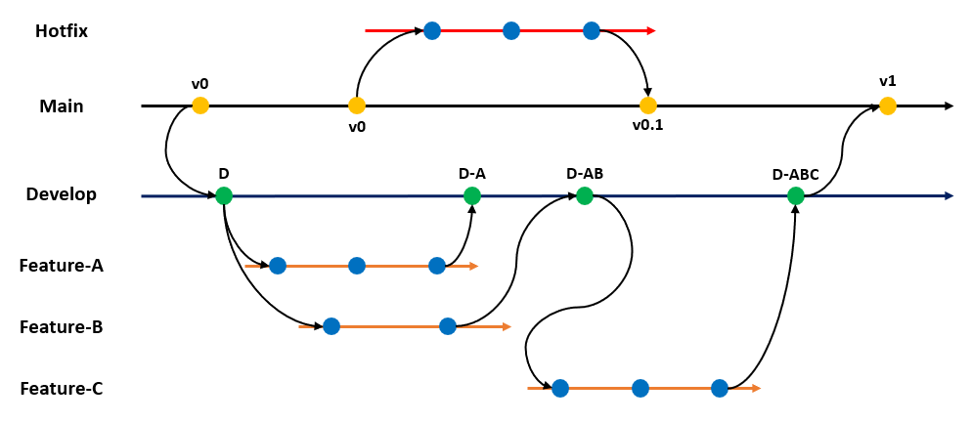
How do branches work?

Slide 9
Hotfix (such as a security fix)
Production (it's expensive if this breaks)
Development (not the end of the world if this breaks) When everything works well it will be merged back into Main
Feature branches (do whatever you want here, they will get merged back to dev when the feature is working)

Slide 10
Many companies have a CI/CD pipeline with actions triggered when code is pushed to a specific branch. These can be used to test code, then push to production if all tests pass.
It is common practice to have a branch created for each new feature. Compared to older source control solutions, Git is extremely easy and fast to create and merge branches (one of its biggest strengths)

Slide 11
GitHub

Slide 12
What is Github?
First, what is a remote?
A remote is a server that is not your local computer. You can set up multiple remotes, but you will likely only use one.
GitHub is a service owned by Microsoft that allows you to have a remote already configured. It also allows a few additional management features that enhance the experience over regular Git.

Slide 13
How do you use GitHub?
When you have a repository set up, you can commit code to it on your own computer.
There are a few main things you will do to interact with GitHub:
1. `git push` - this will push all committed changes to the remotes
2. `git pull` - this will pull all changes from the remote to your local computer
3. `git fetch` - this will fetch the commit history from the remote and compare it to yours. If there are differences, it will tell you if you should pull new code or if you have commits that have not been pushed yet.
4. `git clone <repository path>` this will download a copy of the repository from the remote (along with a folder called .git)

Slide 14
What is .git?
.git is a directory generated when you create a repository. Since it starts with a ".", it is generally treated as a hidden directory.
.git contains information about the repository including:
The commit history
Information about remotes
.git is what makes a directory into a repository

Slide 15
What is .gitignore?
.gitignore is a file that tells Git to ignore certain files in a directory.
When using a command line, Git will only track files added with the `git add` command.
When using a tool like the VSCode source control feature, it tries to be helpful and adds any file added to the working directory into the repository. If you don't want something added (like a .env file with API keys, or a secrets.json with database credentials), just add the file name to .gitignore.

